Slide 1
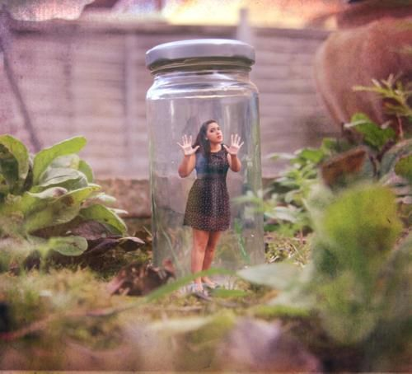
Today you are going to write a narrative or story.
Part of your idea is this girl in the jar.
Who is she?
Why is she there?
How did she get there?
What will happen to her?

Slide 2
Think about:
the characters and where they are
the complication or problem to be solved
how the story will end.
Remember to:
plan your story before you start
write in sentences
pay attention to the words you choose, your spelling and punctuation (capitals, full stops etc), and paragraphs
check and edit your writing when you are finished.

